Slide 1
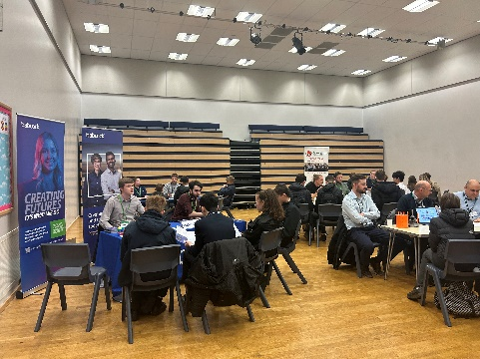
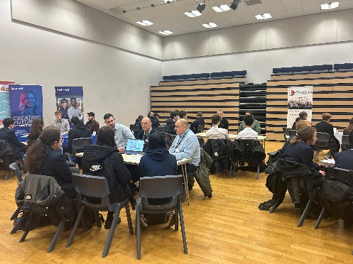
February 2024
CAREERS NEWSLETTER
GORDANO SCHOOL CAREERS NEWSLETTER
DREAM BIG
Careers Newsletter Term 3 of 2023/24.
Event Success
Careers Teatime Networking Event – Engineering
Our second Tea Time Networking event of the year was Engineering and we were so pleased to be able to welcome some of the top Engineering companies to Gordano School. Airbus, BAE Systems, Baker Hughes, Babcock, BEMA and Edwards Vacuum all spent well over an hour talking to and answering questions from our students. Engineering is such an important industry sector with lots of apprenticeship opportunities and so it is important for students to learn as much about the industry as possible and this was a great opportunity to talk to the Companies direct.
Upcoming Events
Target Audience Y9-13
Teatime Networking – Health Industries. The next teatime networking event will be Wednesday 6 March 3:30-4:30pm. Please complete this form to register for the event: SIGN UP HERE
Target Audience Y10
Y10 Employability Skills Programme (Mock Interview Day): Students are now halfway through this programme to develop their employability skills to prepare them for the future. So far they have chosen a ‘job’ to apply for, prepared a CV and looked at interview skills. The next stage is the ‘Mock Interview’ with an employer on Thursday 29th February. We have been overwhelmed with offers from employers to take part in this event and it is testament to how much they enjoy working with our school and our students. Students will be allocated a time to come to the main hall for their interview. It’s a great event and we hope the students are looking forward to taking part in it!
Target Audience Y7/8/9
Careers Programme – Friday Tutor Time. Our programme continues this coming term for Year 9 with session all about Apprenticeships and a visit from Thatcher’s Cider on 22nd March to talk about what they offer.

Slide 2
February 2024
Upcoming Events continued
Target Audience Y11
Gordano Sixth Form Applications – the deadline for applying to Sixth Form was the end of January, however if your child decides they would like to make a late application this is still possible. If your child is finding it hard to make decisions about applying or what subjects to take please ask them to contact Mrs Gardiner or Ms Jones either direct by coming to the Careers Office or through their tutor.
Target Audience Y10
Year 10 Work Experience
Year 10 work experience will take place 1-5 July 2024 this is a compulsory part of our curriculum and provides students with an opportunity to experience what working life is like. As you know we are using Unifrog for the first time this year to record and monitor placements. Students need to find their own placement and then enter this on their Unifrog account. All students already have login details for Unifrog. We are getting a steady trickle coming through which is really good to see. Our deadline for every student to have a placement sorted is Thursday 28 March, this gives us time to ensure that all the employers have completed and sent through their Risk Assessments and Insurance details so that we can approve the placement. If your child is having any problems using Unifrog or would like any help or advice about finding a placement please ask them to come to the Careers Office or email careers@gordanoschool.org.uk
Interested in LAW for Work Experience: WLECN are offering a week of Work Experience across a number of Law firms. Follow this link to apply Year 10 Experiences of the workplace Legal Insight Week applications
National Apprenticeship Week 5 – 11 February
Target Audience ALL
Broaden your knowledge on apprenticeships. Answer Q;s such as: What are they? What sectors can I do one in? Follow this link for a full list of events National Apprenticeship Week
College Open Events
Target Audience: Y10+
City of Bristol College: FULL DETAILS
13 March All Campuses and courses 5.00 – 7.30pm
8 June – Open event 10.00 - 01.00pm
South Gloucestershire and Stroud College(SGS): 25 April 5.30 – 8.00pm: All Campuses: FULL DETAILS
Weston College: FULL DETAILS
6 February 16.00 – 19.00 Weston College Apprenticeship Open Evening
8 February 16.30 – 18.30 Jobs and Apprenticeship Recruitment Event
13 March 17.00 – 19.00 Open Evening
Bridgwater and Taunton College: FULL DETAILS
Bristol City Robins Foundation (Sport, Media, Esports) FULL DETAILS
Online Live Q&A 18 March 16.30
Boomsatsuma: 5 February FULL DETAILS
Access Creative: 27 February 6 – 7.30 FULL DETAILS

Slide 3
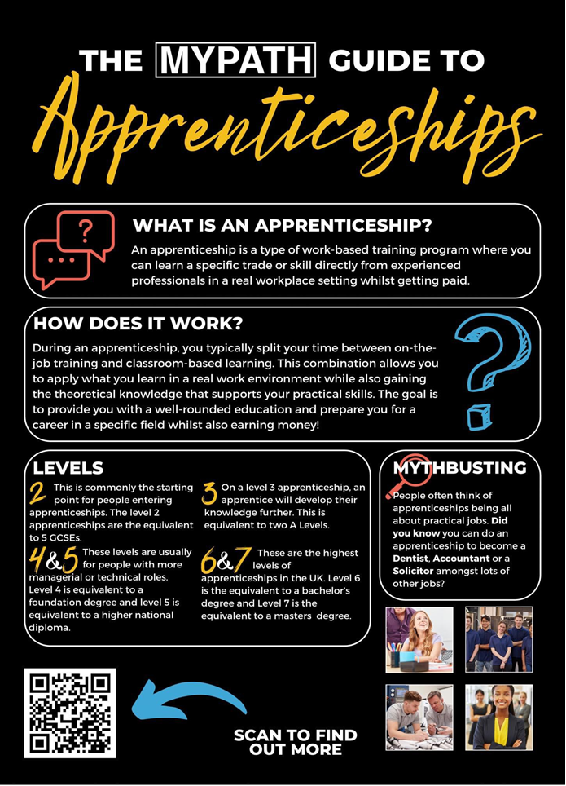
February 2024
Apprenticeship information
Apprenticeships are becoming a much more popular choice for students
At Post 16 and Post 18 levels. We have had a series of talks and workshops
So far this year with Year 11 and Year 13 students and we will be working
With other year groups later next year. Here is some useful information
All about Apprenticeships
Target Audience: Y10 onwards
Parents Apprenticeship zone –https://amazingapprenticeships.com/parent-zone/
Search for current vacancies - https://www.gov.uk/apply-apprenticeship
Post 18 Apprenticeships - If you are in Y13 there are a number of degree apprenticeships currently being advertised. Use both the gov.uk website and www.notgoingtouni.co.uk to explore these opportunities.
Parent and Carer Apprenticeship Information Evening will be hosted one in each local authority and open to all. There will be a panel of employers, apprentices and training providers to answer questions and share their experiences. All will run from 17:30 – 19:00
Tuesday 20th February, Bristol Cathedral School
NORTH SOMERSET Wednesday 21st February, Priory Community School
SOUTH GLOS
Tuesday 27th February, Abbeywood Community School
B&NES
Wednesday 28th February, Bath College
Weston College Apprenticeship Events: Weston College are holding 2 evening event dedicated to Apprenticeships on 6 and 8 February. You can find out more here: FULL DETAILS
Target Audience Y10 –Y13
Burgess Salmon Student Information Days: 10 am to 4pm
25th March: Year 10/11 student sign up
28th March: Year 12/13 student sign up
Vacancies of the month
Degree Level Apprenticeships – there are a large number of degree level apprenticeship opportunities currently available on the Find an Apprenticeship website. Atkins Ltd have a wide range of vacancies including Nucleur Scientist/Engineer, Chartered Surveyor, Civil Engineering plus more. GKN and Babcock also have Apprenticeship opportunities advertised. Search Here for current degree apprenticeship vacancies.
GKN Apprenticeships – as well as degree apprenticeships GKN have vacancies for Post 16 students. Details can be found HERE
BAE Apprenticeships – Recruiting for both Post 16 and 18. Further details can be found HERE. Our recruitment window for next year intakes (September 2024 Start) ends on 28th February
MOD – DE&S. Are currently recruiting for a number of positions both Post 16 and Post 18. further details can be found HERE
Lloyds Banking Group – have apprenticeship opportunities in Bristol for Year 13 students
HR Apprenticeship leading to L5 CIPD qualification: Look Here
Internal Audit apprenticeship leading to L7 Masters in Internal Auditing: Look Here
Financial Services Professional apprenticeship leading to Chartered Banking Institute Advanced Diploma in Banking:
Look Here

Slide 4
February 2024
National Highways Apprenticeship Webinar
Who are National Highways?
Our apprenticeships and what it means to do an apprenticeship with us- what are we offering and what are the misconceptions.
Our employee networks and how our apprentices can get involved.
Find the link to registration and our careers page here where all our vacancies will also be going live on Monday 5th February.
Spotlight on LAW
Law Apprenticeship Webinar – Irwin Mitchell Wednesday 7th February – 6pm
Target Audience Y10+
Our Early Careers team is hosting an external webinar during National Apprenticeship Week 2024 to provide insights into the legal and non-legal apprenticeships available with us for 2024.
Attendees can sign up via our website here - Apprenticeships at Irwin Mitchell
Osborne Clarke are looking for Solicitor Apprentices to join in Bristol in September 2024. Solicitor Apprenticeships offer the opportunity to study an undergraduate law degree and train as a Solicitor whilst earning a salary, without the cost associated with going to university.
Find out more at our open evening for students and parents/carers:
On – Thursday 15 February 2024
From – 5.30pm
At – Osborne Clarke, Halo, Counterslip, Bristol, BS1 6AJ
To secure your place sign up here - https://forms.office.com/e/Zg6MnWMrnY
Additional information can be found online at https://www.osborneclarke.com/solicitor-apprenticeship/
University Information
Target Audience Y12+
Swansea University are offering one hour Masterclass Sessions (5-8 February 5-7pm) on a range of different subjects. The webinars are run by expert lecturers please follow this link for further details.
Remember all universities are running events so please do check out their webpage for listings or visit https://www.opendays.com/calendar/
Interested in Medicine?
A couple of really interesting links on applying for medicine and overview of the universities that offer medicine.
Year 11/12- Statistical Overview of Applying to Medical School in the UK
Year 12/13 - All UK Medical Schools Interview Processes

Slide 5
February 2024
Gap Year/Internship Information:
Target Audience Y12/13
Industrial Placement Schemes IBM Careers Placements (age 17 & over) https://www.ibm.com/uk-en/employment/entrylevel/#Futures_12_Month_Placement_Scheme
EDT (etrust.org.uk) Ideas https://www.etrust.org.uk/the-year-in-industry
Independent Gap Advice https://independentgapadvice.org/
Yipiyap – Gap Year Employment Opportunity (tutoring) INFO
Labour Market Information
Target Audience All Years
Labour Market Information is key to making good Career choices as it researches and explains what job sectors are growing or declining. The following resources are useful to explore local and national LMI:
Careerpilot : Jobs
Explore LMI data – LMI For All
West of England – Labour Market Inteligence
North Somerset Employment and Skills Strategy
The Careers Team -Who’s who?
Mrs Fairs – Strategic lead for Careers
Mrs Van Den Eekhaute-Jones – Teacher Lead for Careers
Mrs Gardiner – Careers Adviser
Ms Jones – Careers Adviser
If you would like to discuss your career ideas please contact careers@gordanoschool.org.uk for an appointment.
How can Unifrog help me?
Explore what subjects you would be interested in studying Post 16/18
Explore different job profiles.
Explore universities/apprenticeship opportunities.
Discover and sign up for online courses
Record all your key activities and achievements
www.unifrog.org
All students in Years 7 – 13 have a Unifrog log in Students can email careers@gordanoschool.org.uk if their log in needs renewing.
Parent login: GDSCParents

